Slide 1
The Best Part
Notes:
It was 20 years ago next year.

Slide 2
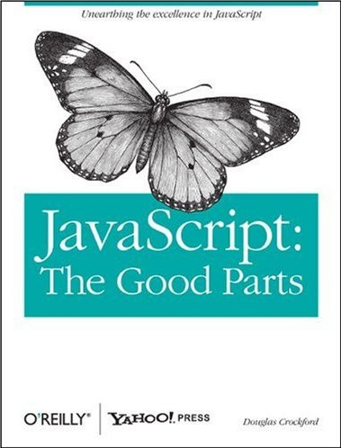

Slide 3
Review
What I thought was good that is still good.
What has been added since which is good.
What did I thought was good that was not.
Discussion.
But first, an historical retrospective.

Slide 4
The World’s Most Popular Programming Language

Slide 5
The World’s Most Popular Programming Language
The World’s Most Unpopular Programming Language

Slide 6
It is the language that people use without bothering to learn it first.
Programming is complicated business. It should never be undertaken in ignorance.

Slide 7
A language of many contrasts.

Slide 8
JavaScript is succeeding very well in an environment where Java was a total failure.
Applets, thin clients, fail.

Slide 9
The broadest range of programmer skills of any programming language.
From computer scientists
to cut-n-pasters
and everyone in between.

Slide 10
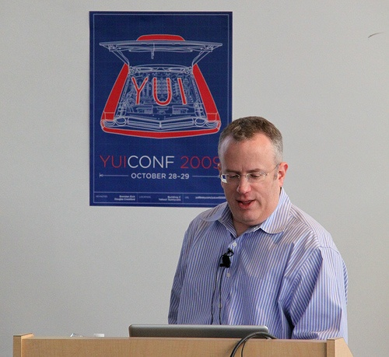

Slide 11
Java
Scheme
Self
LiveScript

Slide 12
Java
Scheme
Self
LiveScript
JavaScript

Slide 13
Java
Scheme
Self
LiveScript
JavaScript
JScript

Slide 14
Java
Scheme
Self
LiveScript
JavaScript
ECMAScript
JScript

Slide 15
Where do Bad Parts come from?
Legacy
Good Intentions
Haste
We can’t remove the bad parts, but you can choice to avoid them.

Slide 16
Why haven’t the bad parts been fixed?
The problem with the bad parts isn’t that they are useless.
The web gives the developer less control over the environment than any other venue.
Once a mistake is added to the web, it can take years to correct it.

Slide 17
Bad Parts
Global Variables
Semicolon insertion
+ adds and concatenates
typeof
with and eval
phony arrays
false, null, undefined, NaN
== and !=

Slide 18
Transitivity? What's That?
0 == '0' // true
0 == '' // true
'' == '0' // false
false == 'false' // false
false == '0' // true
" \t\r\n " == 0 // true

Slide 19
Numbers
Only one number type:
  Having one number type is a good part.
It is IEEE 754 “Double”:
  A bad part.

Slide 20
Decimal fractions are approximate
a = 0.1;
b = 0.2;
c = 0.3;
a + b === c
false

Slide 21
Good Parts
Loose Typing
Dynamic Objects
Object Literals
Functions

Slide 22
Delegation
Differential Inheritance
Prototypes

Slide 23
Writing in ECMAScript language without understanding closure is like writing in Java without understanding classes.
Functions are first class.
Functions are lexically (or statically) scoped (mostly).
this

Slide 24
Style Isn’t Subjective
block
{
....
}
Might work well in other languages
block {
....
}
Works well in JavaScript

Slide 25
Style Isn't Subjective
return
{
ok: false
};
SILENT ERROR!
return {
ok: true
};
Works well in JavaScript

Slide 26
Style Isn't Subjective
return
{
ok: false
};

Slide 27
Style Isn't Subjective
return; // semicolon insertion
{
ok: false
};

Slide 28
Style Isn't Subjective
return;
{ // block
ok: false
};

Slide 29
Style Isn't Subjective
return;
{
ok: false // label
};

Slide 30
Style Isn't Subjective
return;
{ // useless
ok: false // expression
}; // statement

Slide 31
Style Isn't Subjective
return;
{
ok: false; // semicolon
}; // insertion

Slide 32
Style Isn't Subjective
return;
{
ok: false;
}; // empty statement

Slide 33
Style Isn't Subjective
return;
{ // unreachable statement
ok: false;
}

Slide 34
Style Isn't Subjective
return
{
ok: false
};
Bad style
return;
{
ok: false;
}
Bad results

Slide 35
var a = b = 0;

Slide 36
var a = b = 0;
var a = 0, b = 0;
var a = (b = 0);

Slide 37
if (a) b(); c();

Slide 38
if (a) b(); c();
if (a) {b(); c();}
if (a) {b();}
c();

Slide 39
It should be clear from reading a program what it actually does.
Avoid forms that are difficult to distinguish from common errors.

Slide 40
++

Slide 41
++
x += 1

Slide 42
++
x += 1
x++

Slide 43
++
x += 1
x++
++x

Slide 44
Programming is the most complicated thing that humans do.
Computer programs must be perfect.
Humans are not good at perfect.

Slide 45
There will be bugs.
Do what you can to move the odds to your favor.

Slide 46
Language Subsetting
Only a madman would use all of C++.

Slide 47
JSLint
JSLint defines a professional subset of JavaScript.
The Good Parts
http://www.JSLint.com/

Slide 48
WARNING!
JSLint will hurt your feelings.

Slide 50
Review
What I thought was good that is still good.
What has been added since which is good.
What did I thought was good that was not.
Discussion.

Slide 51
What has been added since which is good
Array methods (map, reduce, filter...)
Array.isArray
Object.create freedom from inheritance
Object.freeze strength through immutability
strict mode
string.trim
?.

Slide 52
What did I thought was good that was not.
Prototypal inheritance.
  new
  this
  prototype
'

Slide 53
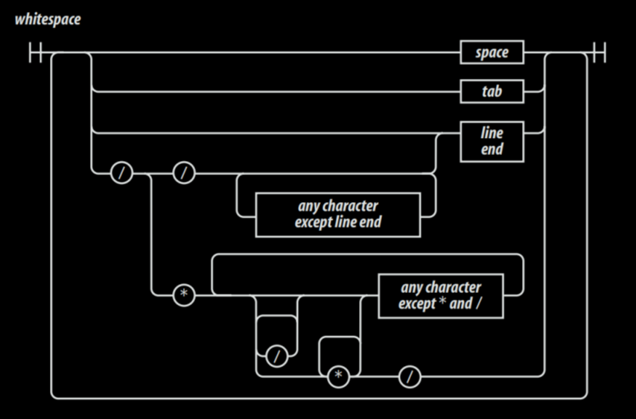
Railroad Diagrams

Slide 54
Write programs that work well
and are free of error.
That's the job.

Slide 55
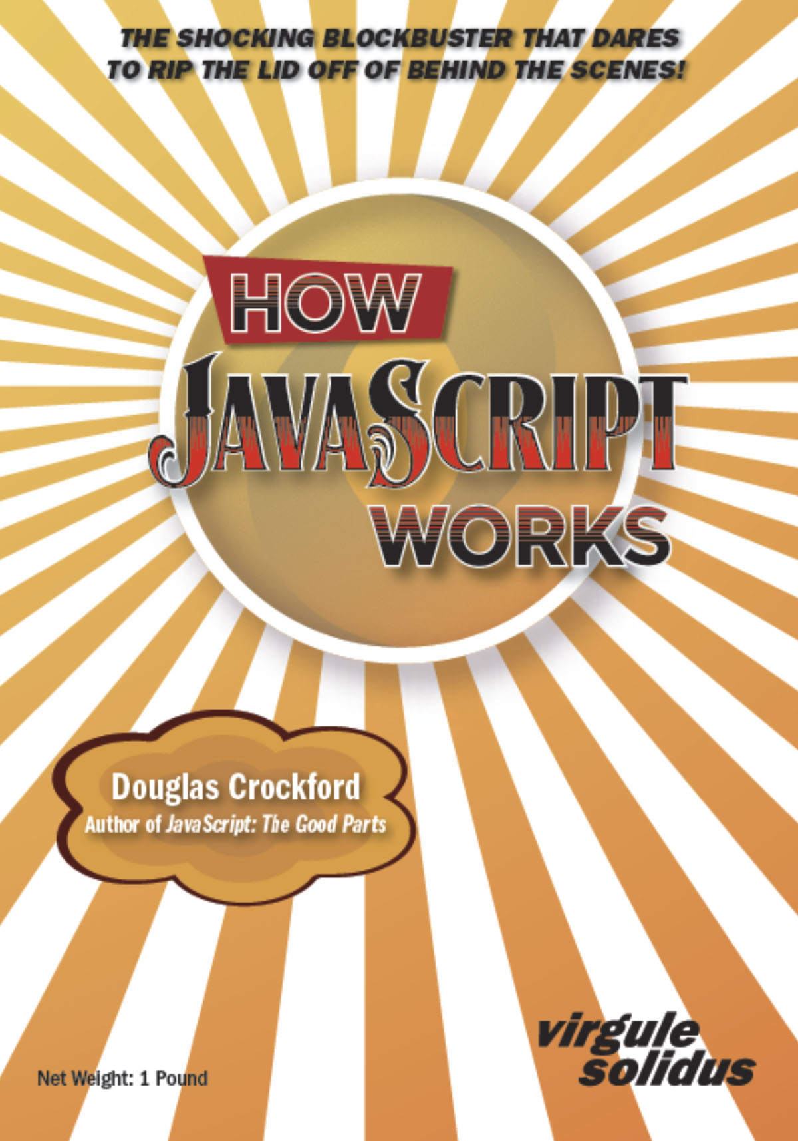

Slide 56
Linkage
https://www.crockford.com/books.html
https://www.crockford.com/jscheck.html
https://www.crockford.com/pronto.html
https://www.crockford.com/javascript/private.html

Slide 57
And finally,
one piece of advice:
Don’t make bugs.

Slide 58
Linkage
https://www.crockford.com/books.html
https://www.crockford.com/jscheck.html
https://www.crockford.com/pronto.html
https://www.crockford.com/javascript/private.html

Slide 59
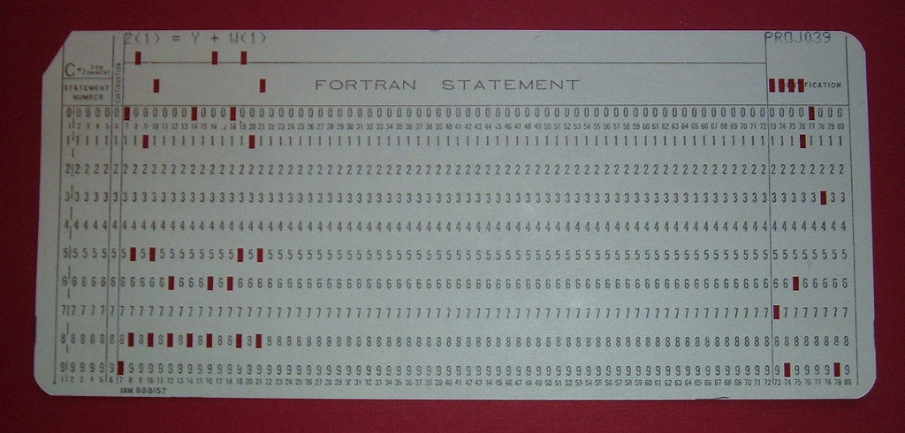

Slide 60
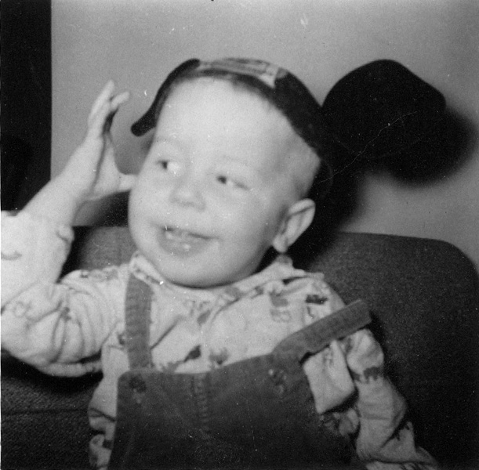
Thank you and good night.

